Slide 1
Voltage, current, resistance and resistance colour coding

Slide 2
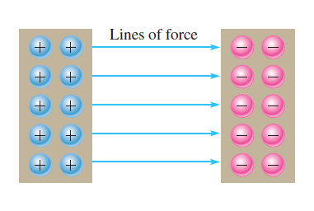
What is an Electric Charge?
Electrical charge is an electrical property of matter that exists because of an excess or deficiency of electrons.
Static electricity is the presence of a net positive or negative charge in a material.
Materials with charges of opposite polarity are attracted to each other, and materials with charges of the same polarity are repelled
A force acts between charges, as evidenced by the attraction or repulsion. This force, called an electric field, is represented by imaginary lines,
One coulomb is the total charge possessed by 6.25 x 10^18 electrons.
A single electron has a charge of -1.6 x 10^(-19) C

Slide 3

Problems on Electric Charge
What is the charge in coulombs of the nucleus of a copper atom?
What is the charge in coulombs of the nucleus of a chlorine atom?
How many electrons does it take to make (microcoulombs) of charge?

Slide 4
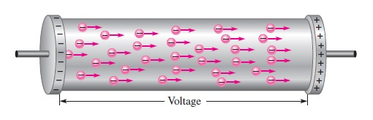
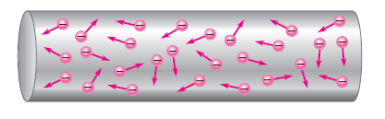
Electric Current
free electrons are available in all conductive and semiconductive materials.
These outer-shell electrons drift randomly in all directions
The movement of these free electrons from the negative end of the material to the positive end is the electrical current, symbolized by I.
Electrical current is the rate of flow of charge
I = Q/t
where I is current in amperes (A), Q is charge in coulombs (C), and t is time in seconds (s).

Slide 5
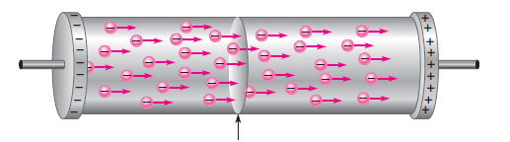
One-Ampere
One ampere (1 A) is the amount of current that exists when a number of electrons having a total charge of one coulomb (1 C) move through a given cross-sectional area in one second (1 s).
Example 1: Ten coulombs of charge flow past a given point in a wire in 2 s. What is the current in amperes?
I = Q/t = 10/2 = 5V
Example 2: If there are 8 A of current through the filament of a lamp, how many coulombs of charge move through the filament in 1.5 s?

Slide 6
Problems on Current
Six-tenths coulomb passes a point in 3 s. What is the current in amperes?
How long does it take 10 C to flow past a point if the current is 5 A?
How many coulombs pass a point in 0.1 s when the current is 1.5 A?
5.74 x 10^17 electrons flow through a wire in 250 ms. What is the current in amperes?
A certain current source provides 100 mA to a 1kΩ load. If the resistance is decreased to 500Ω what the current in the load?

Slide 7
Voltage
A certain amount of energy must be exerted, in the form of work, to overcome the force and move the charges a given distance apart
The difference in potential energy per charge is the potential difference or voltage
Voltage, symbolized by V, is defined as energy or work per unit charge
V = W/Q
V is voltage in volts (V), W is energy in joules (J), and Q is charge in coulombs C. The unit of voltage is the volt, symbolized by V.
The Volt
One volt is the potential difference (voltage) between two points when one joule of energy is used to move one coulomb of charge from one point to the other.

Slide 8


Example 1:
If 50 J of energy is required to move 10 C of charge, what is the voltage?
Example 2:
How much energy is required to move 50 C from one point to another when the voltage between the two points is 12 V?

Slide 9
Problems on Voltage
Five hundred joules of energy are used to move 100 C of charge through a resistor. What is the voltage across the resistor?
What is the voltage of a battery that uses 800 J of energy to move 40 C of charge through a resistor?
How much energy does a 12 V battery use to move 2.5 C through a circuit?
If a resistor with a current of 2 A through it converts 1000 J of electrical energy into heat energy in 15 s, what is the voltage across the resistor?

Slide 10
Resistance
Ohm
the free electrons move through the material
occasionally collide with atoms
These collisions cause the electrons to lose some of their energy, and thus their movement is restricted
This restriction varies and is determined by the type of material
The property of a material that restricts the flow of electrons is called resistance, designated with an R
Resistance is expressed in ohms, symbolized by the Greek letter omega (Ω).
One ohm (1 ) of resistance exists if there is one ampere (1 A) of current in a material when one volt (1 V) is applied across the material.

Slide 11
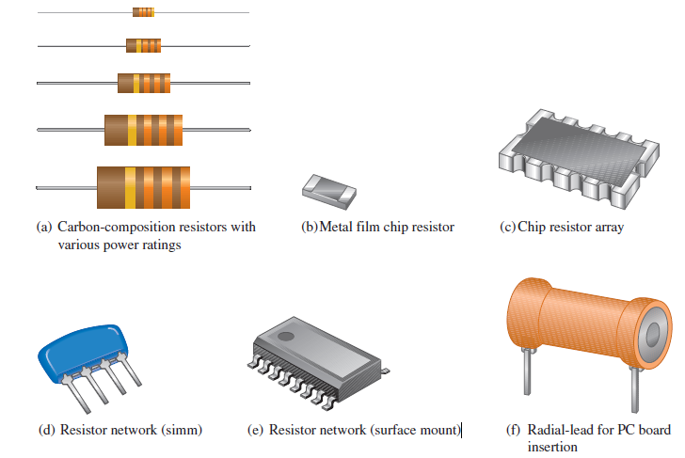
Resistor:
A component that is specifically designed to have a certain amount of resistance is called a resistor. The principal applications of resistors are to limit current in a circuit, to divide voltage, and, in certain cases, to generate heat
Fixed Resistors: Fixed resistors are available with a large selection of resistance values that are set during manufacturing and cannot be changed easily. They are constructed using various methods and materials.

Slide 12
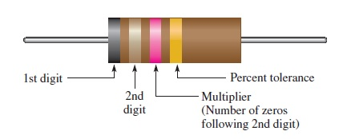
Resistor Colour Coding
Fixed resistors with value tolerances of 5% or 10% are color coded with four bands to indicate the resistance value and the tolerance
The color code is read as follows:
Start with the band closest to one end of the resistor. The first band is the first digit of the resistance value. If it is not clear which is the banded end, start from the end that does not begin with a gold or silver band.
The second band is the second digit of the resistance value.
The third band is the number of zeros following the second digit, or the multiplier.
The fourth band indicates the percent tolerance and is usually gold or silver.

Slide 13
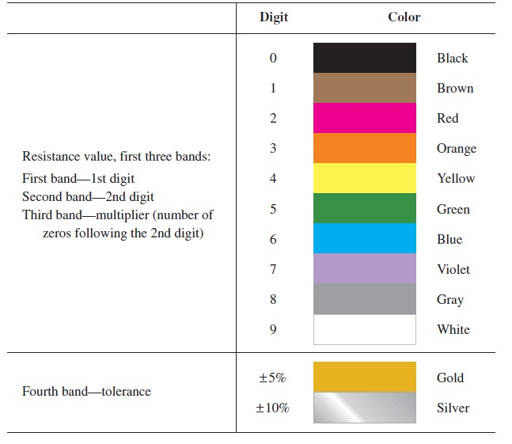

Slide 14
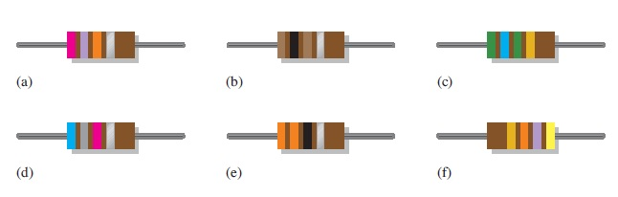

Slide 15
Reference Book
Principles of Electric Circuits Floyd 9th Ed.

